Slide 1

Let’s go!
A geographical transient social network

Slide 2
What’s Let’s Go?
A social network!
A user can post his current status.
The status will got annotated on the map.
We already have a lot of social networks. Why do we need another one?
Transient
Geographical
Local
Based on maps!
Notes:
That’s because the status data here are transient. I’m expiring them after 20 minutes.
This social network is geographical and based on maps.
And also, it’s local. I can see just the statuses sent around me.

Slide 3

It’s transient!
All the data will be wiped out from the servers in 20 minutes.
From this perspective, it acts like Snapchat. No permanent data.

Slide 4
It’s local
The server will just send back to user the statuses happened in her neighborhood.
The radius is 5 miles for now.
Rails Server will filter out the other statuses

Slide 5
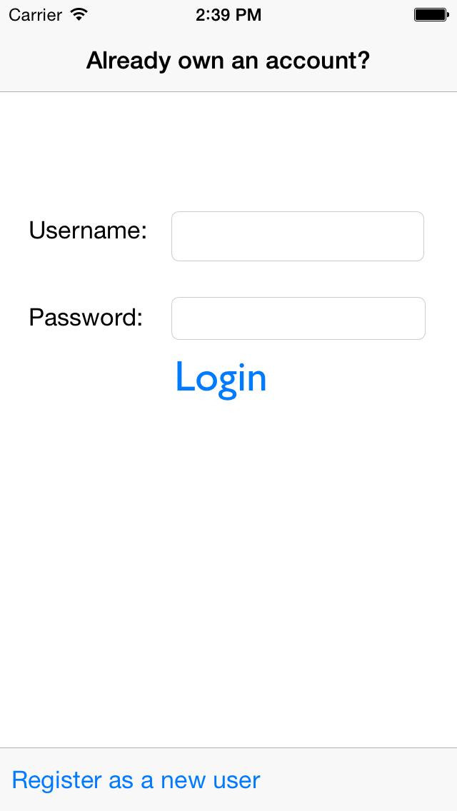
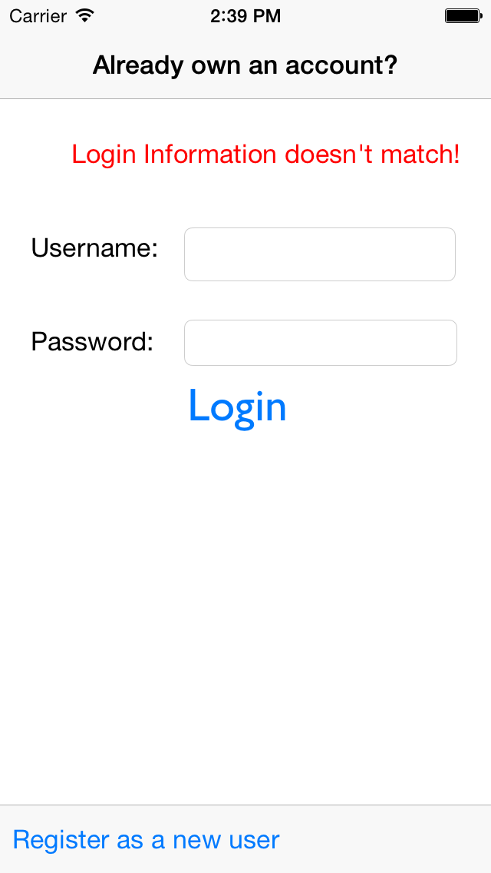
How does it look like? (Login)

Slide 6
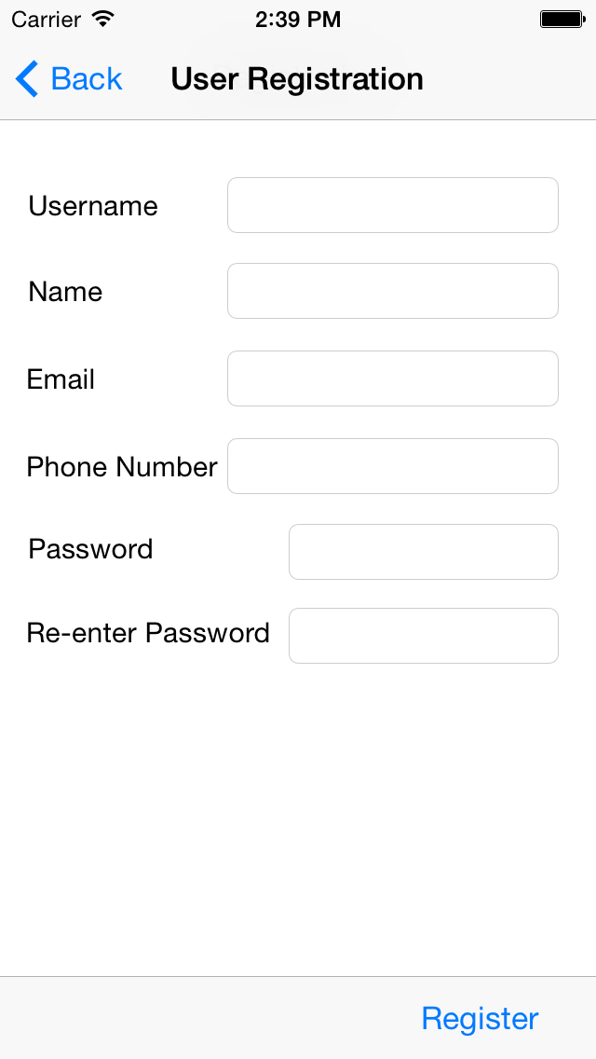
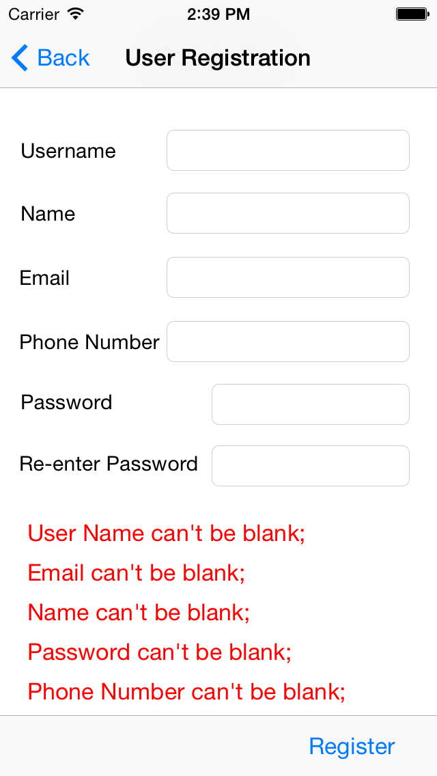
Register User

Slide 7
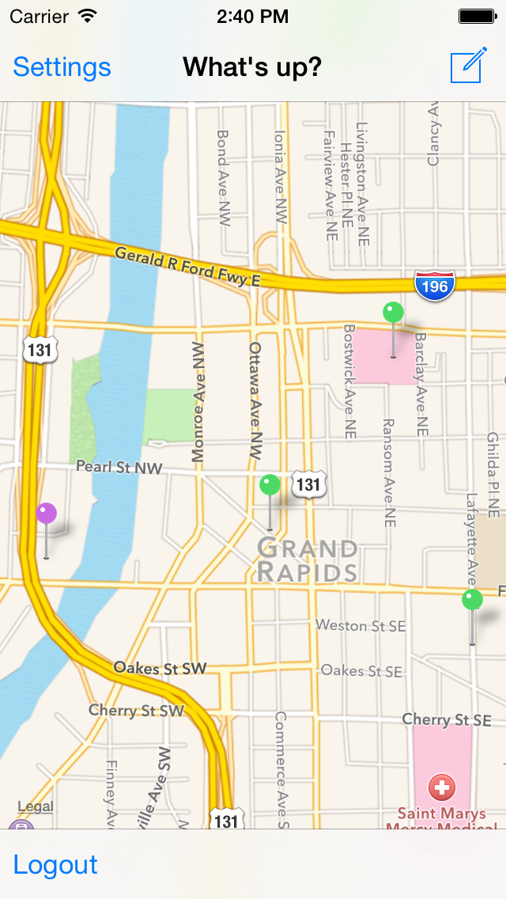
Map
I’m fetching the statuses every one minute

Slide 8
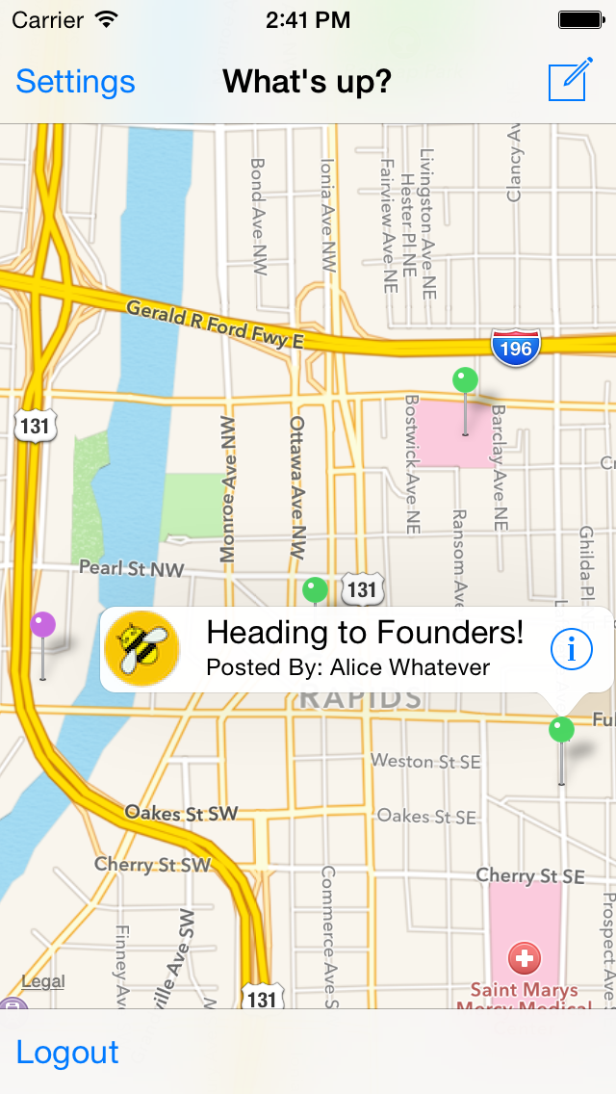

Slide 9
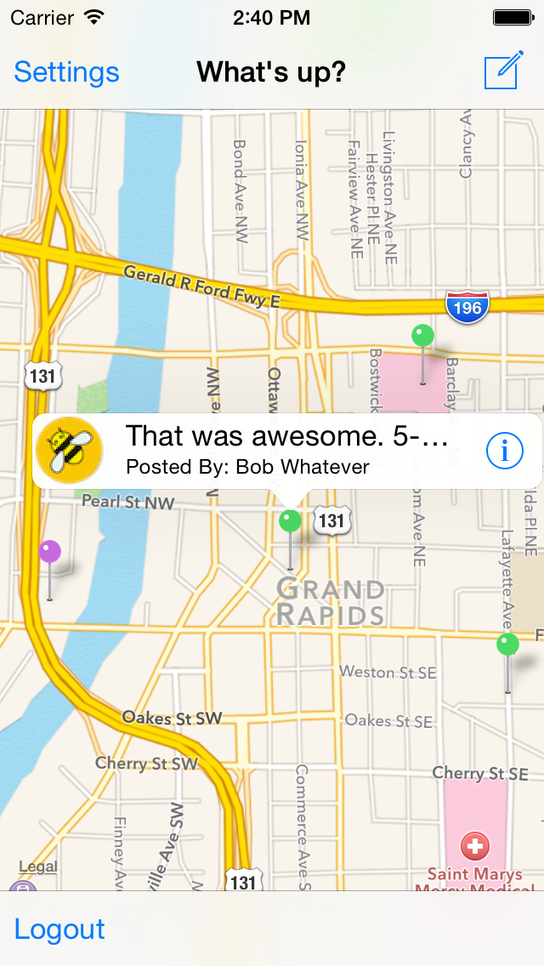

Slide 10
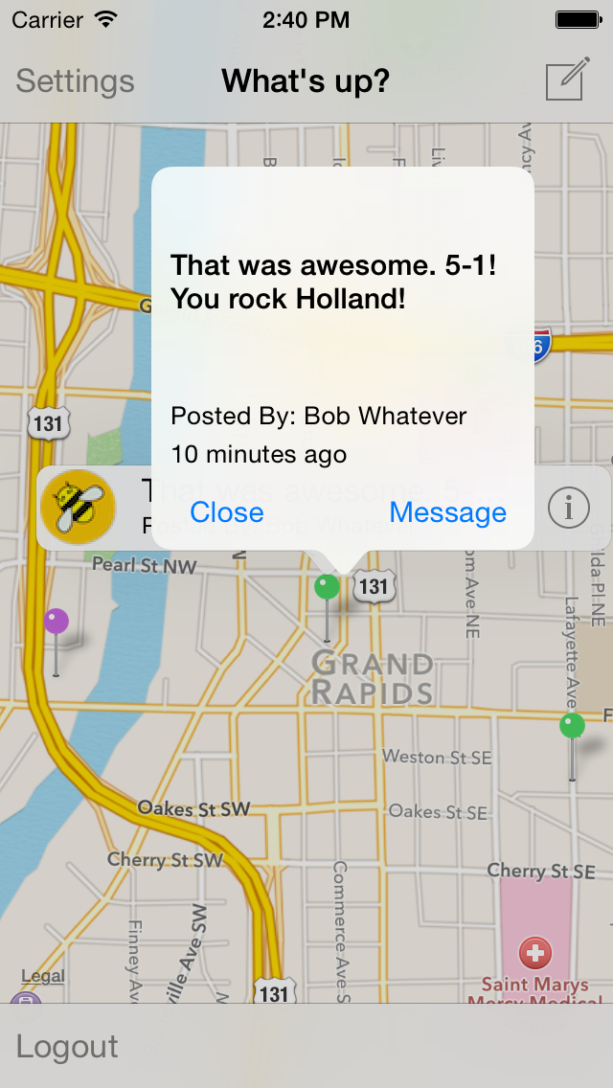

Slide 11
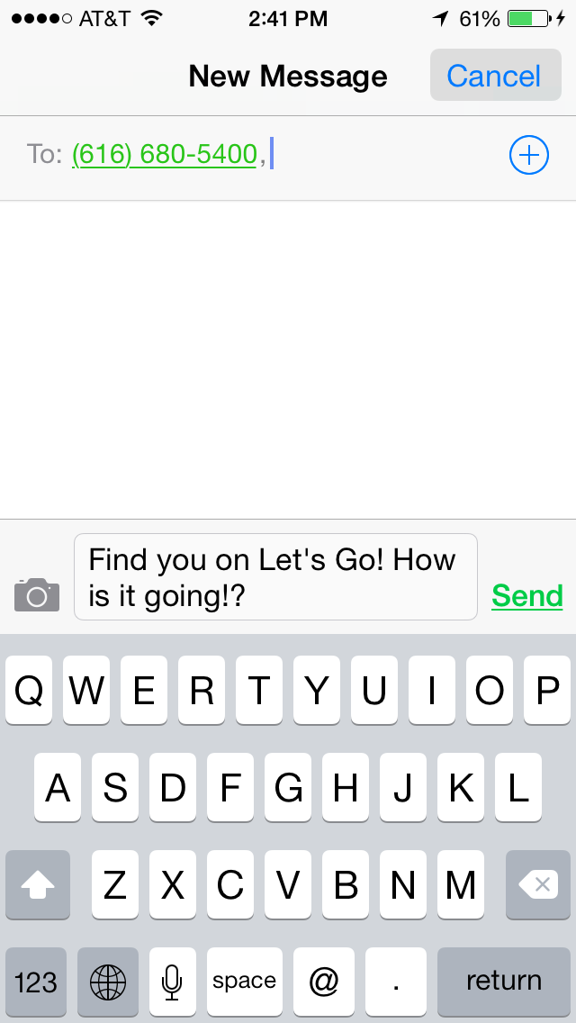
Messaging: It’s creepy I know, but all social networks are creepy to a certain degree :D

Slide 12
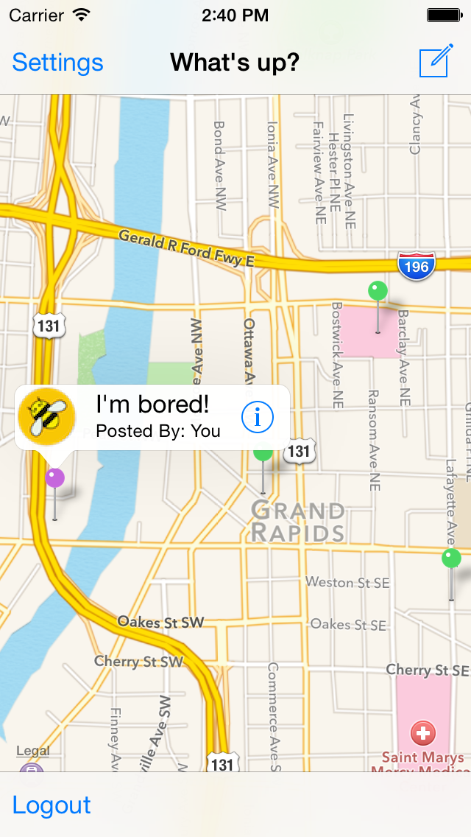
My Status

Slide 13
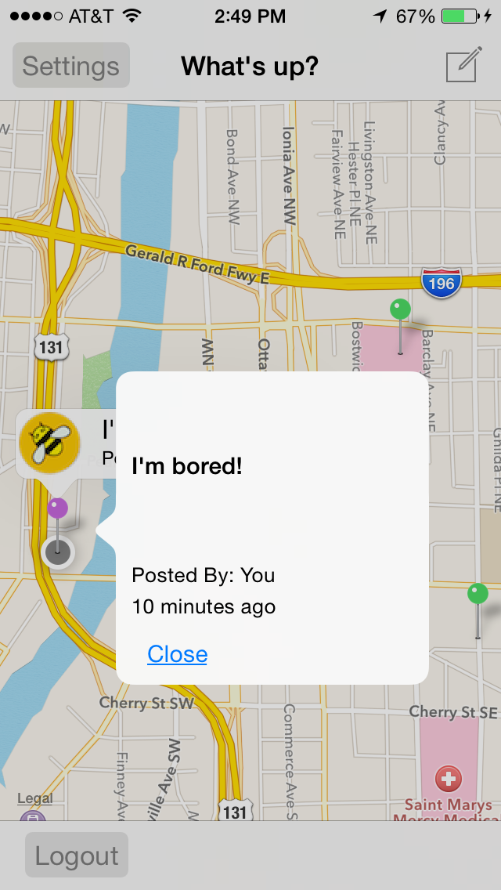

Slide 14
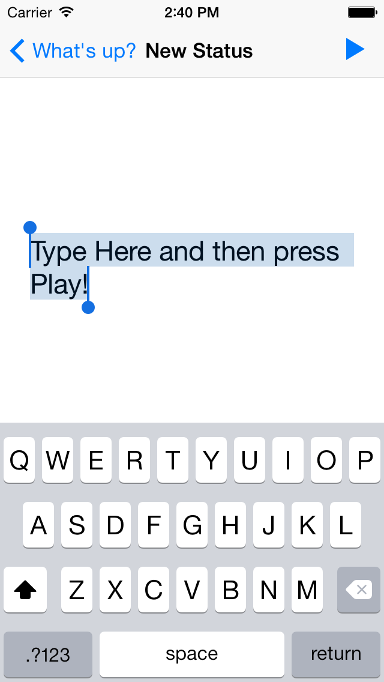
‘Play’ your status!
New Status
Each user can just have one status at a time.

Slide 15
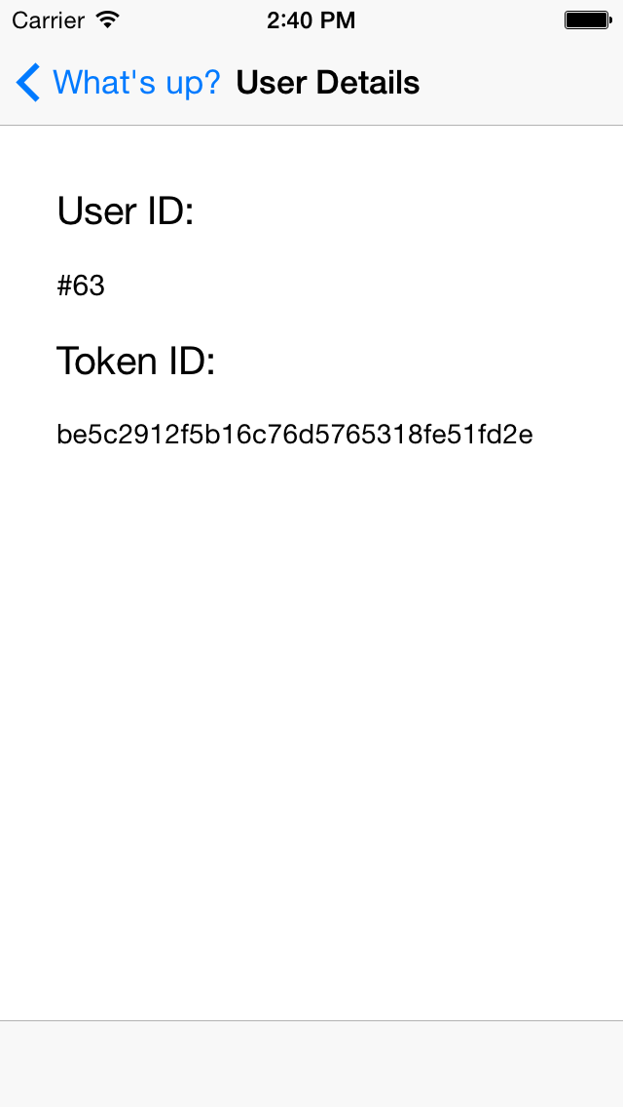
Settings Page. For now just User ID and Token#

Slide 16
Backend
I’m using Ruby on Rails.
Nothing is wrong with parse.com
I just like complete authority.
A personal choice
If I wasn’t in rush, I would choose lovely clojure

Slide 17
Backend (Cont.)
I’m not using normal Rails, just Rails::API
By using it, we limit our Rails app to include only things necessary for API-driven apps.
$ gem install rails-api
It’s hosted on Heroku
http://lets-go.herokuapp.com

Slide 18
Public APIs
Registration
POST http://lets-go.herokuapp.com/users
Login
POST http://lets-go.herokuapp.com/sessions
Status List
POST http://lets-go.herokuapp.com/statuses/list
Status Creation
POST http://lets-go.herokuapp.com/statuses/

Slide 19
Single Sign-in
There is no need for logging in at every execution of the app.
Storing token in keychain
Using UIKeyChainStore library

Slide 20
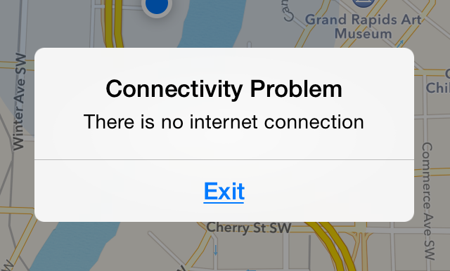
Internet connectivity

Slide 21
Defining a URL Scheme
The Scheme name of a URL is the first part of the URL.
schemename://
For web, the scheme is http or https
letsgo://

Slide 22
Any Question?
???

